Slide 1
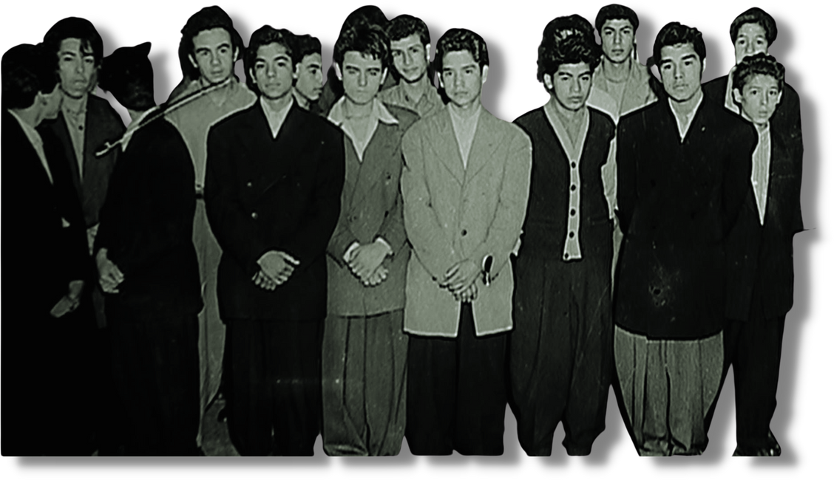
THE SLEEPY LAGOON
ZOOT SUIT TRIAL
People v. Zammora
1942
Prepared by the Los Angeles County Superior Court Latino Judicial Officers Association

Slide 2
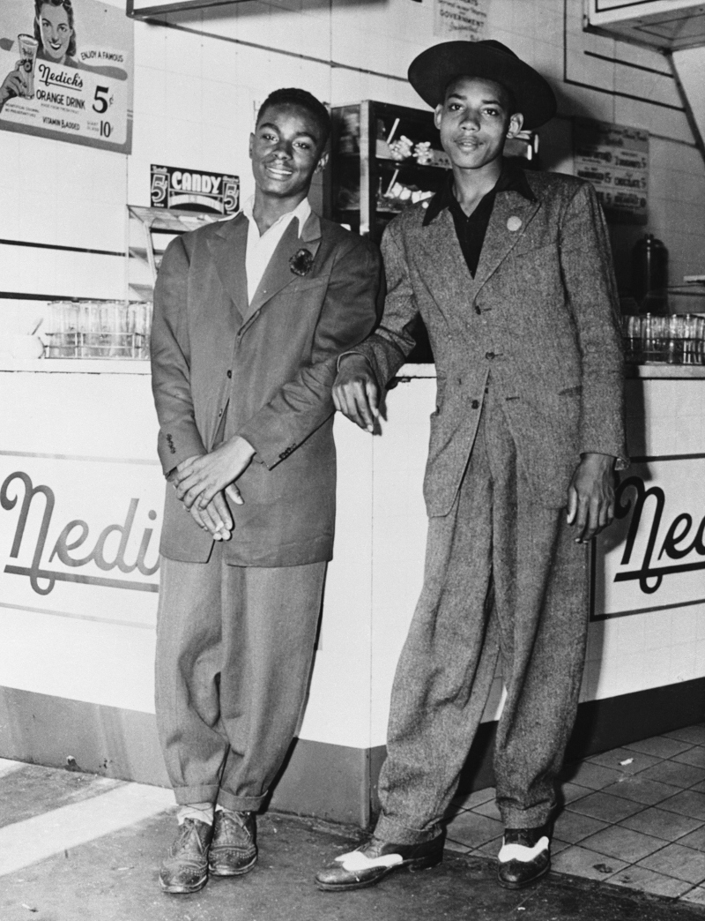
THE ZOOT SUIT
oversized, high-waisted, wide-legged suits
became popular in African American, Mexican American, Filipino American, Italian American, and Japanese American communities during
the 1940s
became a cultural expression

Slide 3
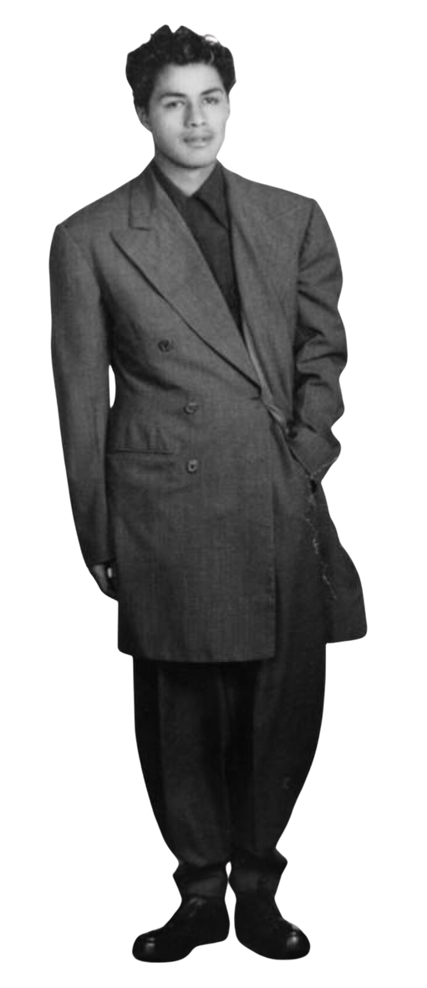
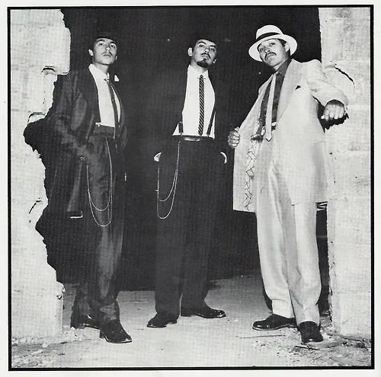
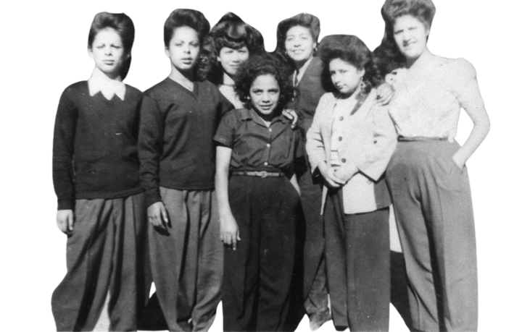
PACHUCOS AND PACHUCAS

Slide 4
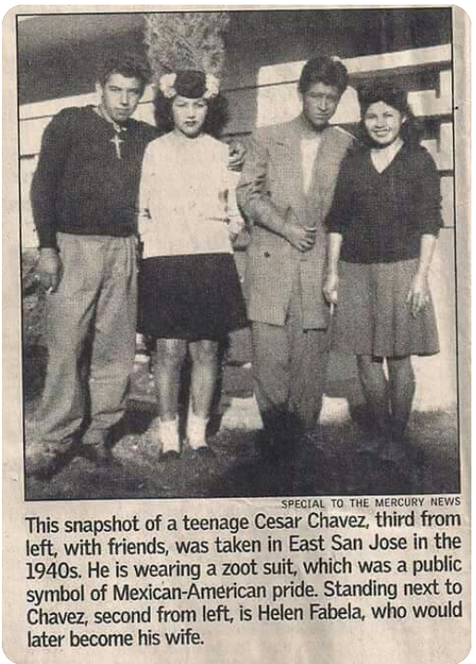
"In those days, I was prepared for any sacrifice to be able to dress the way I wanted to dress. I thought it [the zoot suit] looked sharp and neat, and it was the style" -- César Chávez

Slide 5
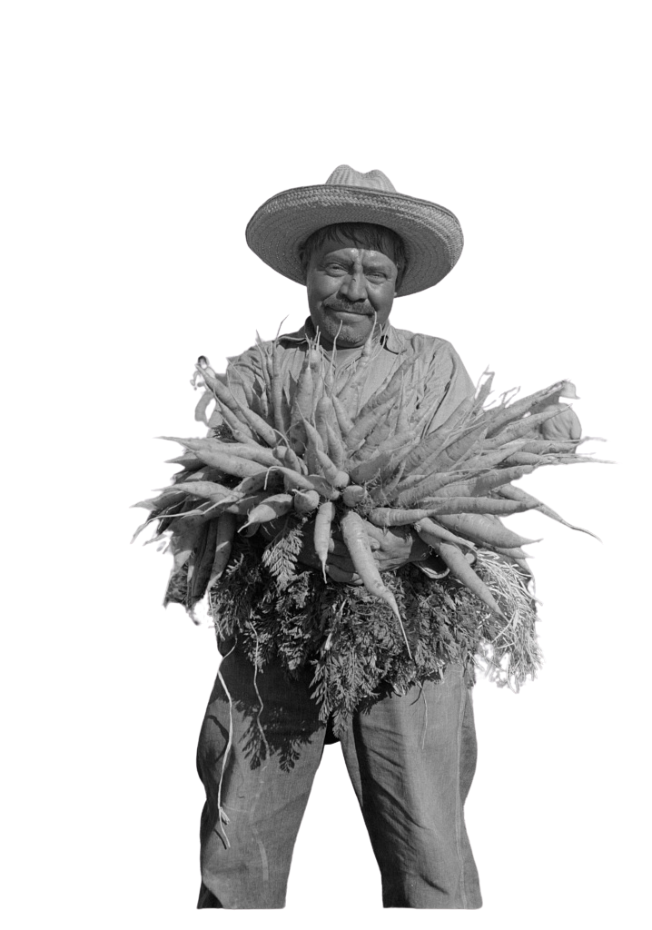
Los Angeles 1940s
There were “whites only” schools and "Mexican schools"
Mexican-Americans were not allowed to go to movie theaters (some theaters let them sit in the balcony)
Non-whites were not allowed to enter swimming pools while white people swam

Slide 6
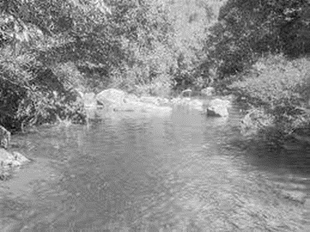
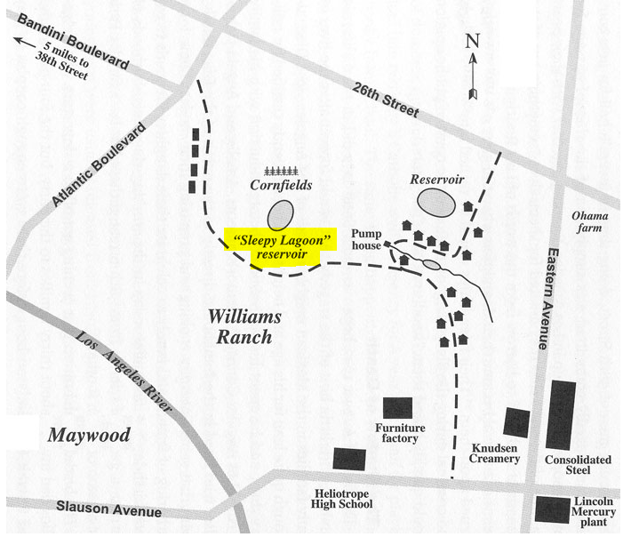
WILLIAMS RANCH AREA OF EAST LOS ANGELES
SLEEPY LAGOON

Slide 7
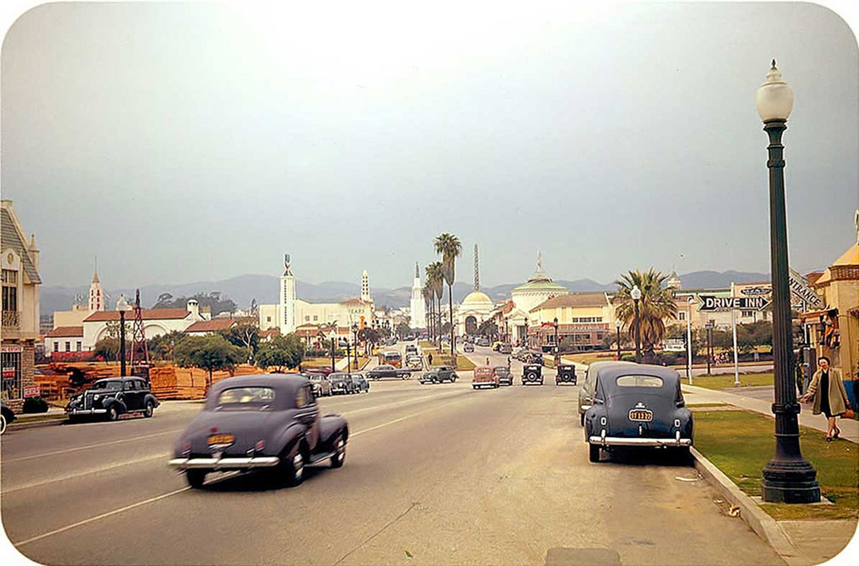
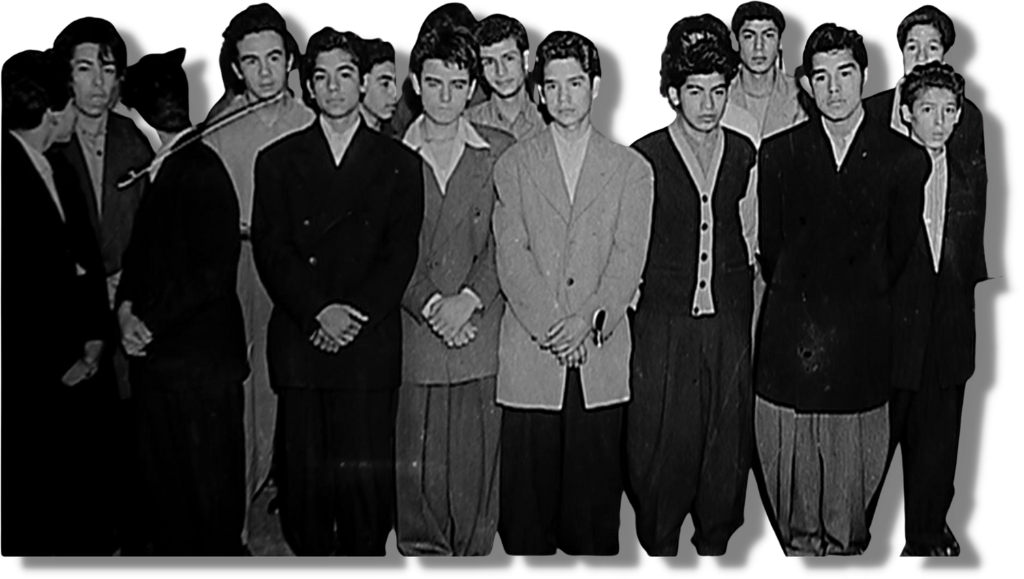
SLEEPY LAGOON MURDER:
August 1942
12 INNOCENT YOUNG MEN WERE FOUND GUILTY

Slide 8
SLEEPY LAGOON MURDER:
August 1942
BECAUSE OF WHO THEY WERE, NOT WHAT THEY DID

Slide 9
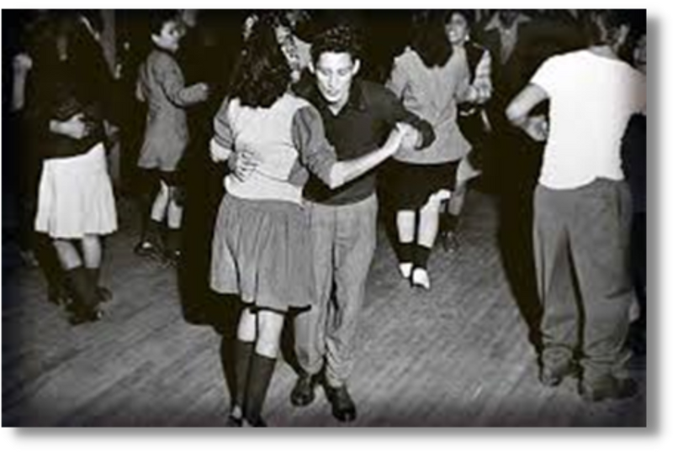
AUGUST 1, 1942
A house party is held on the Williams Ranch.
A group is hanging out at the nearby lagoon late into the night.
Several rival groups come and go, there’s a fight.

Slide 10
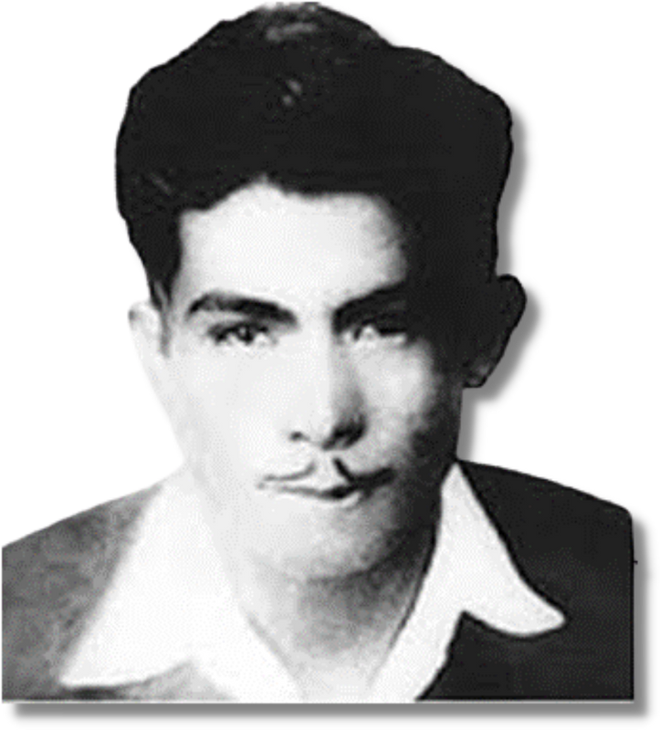
AUGUST 2, 1942
José Díaz, a 22-year-old farmworker, is found the next morning badly beaten and unconscious.

Slide 11
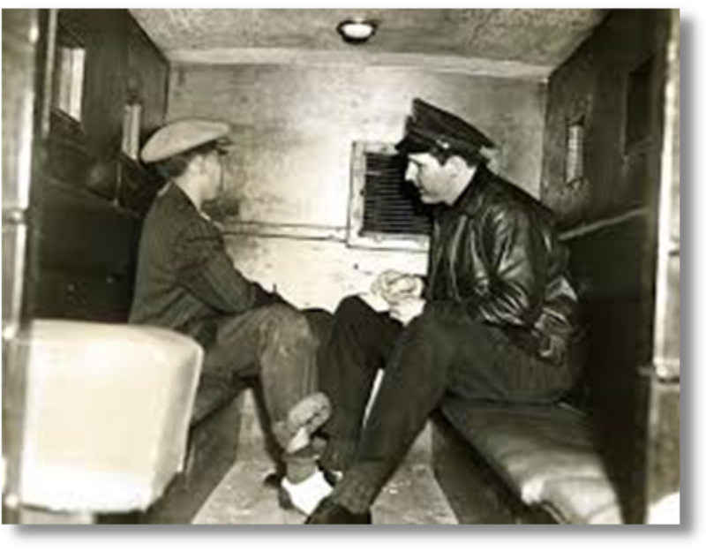
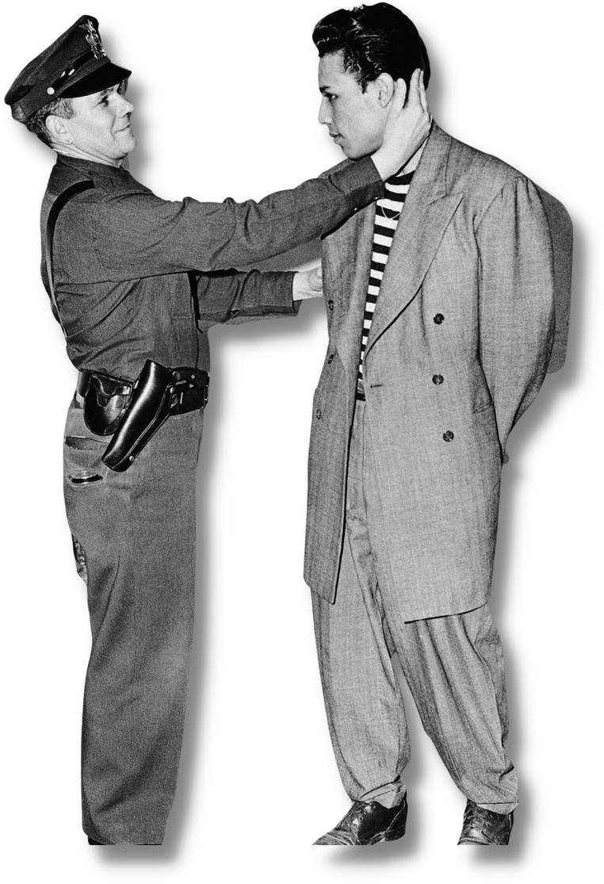
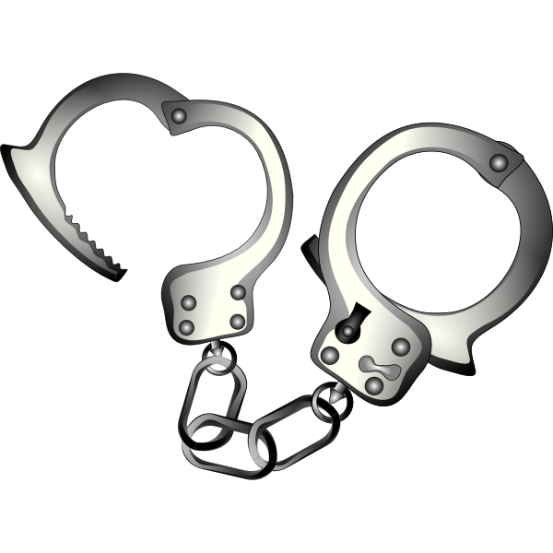
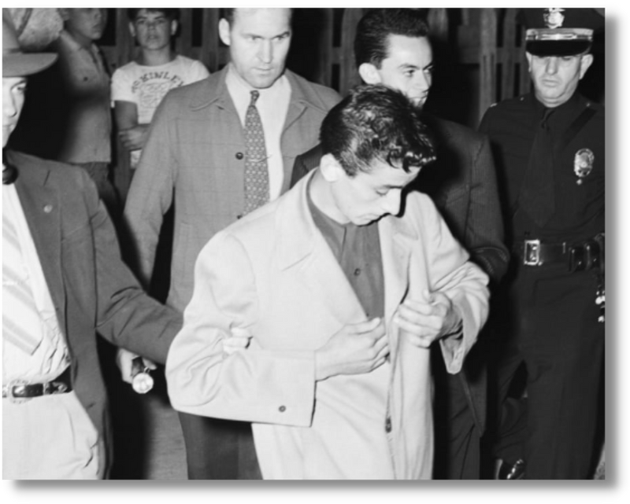
AUGUST 2-10, 1942
300-600
ARRESTS

Slide 12
Welcome: Judge Maria Evangelista San Francisco Superior Court

Slide 13
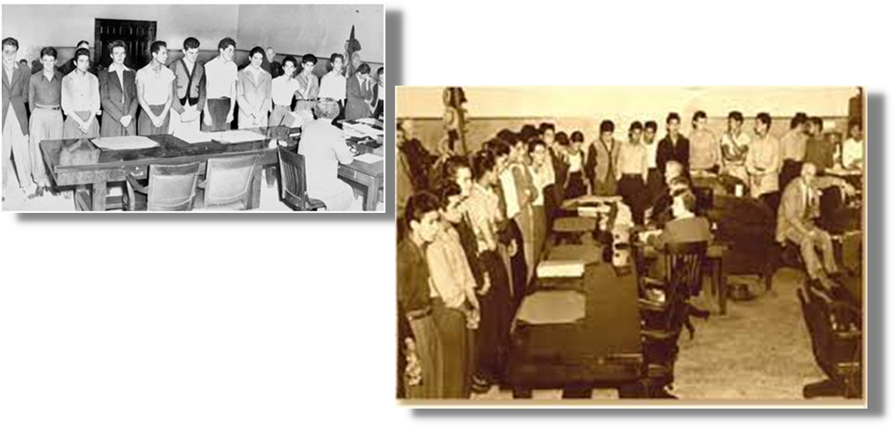
AUGUST 18, 1942:
GROUP ARRAIGNMENT
1 Trial
22 people
7 attorneys

Slide 14
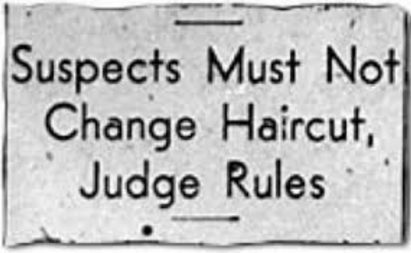
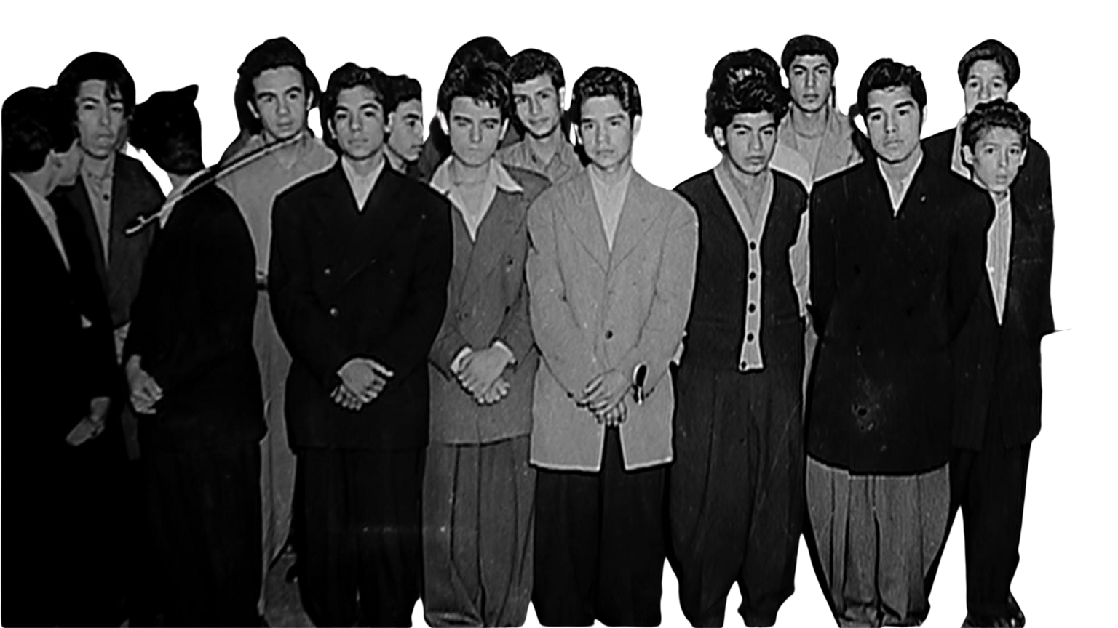
22 are charged with killing José Díaz

Slide 15
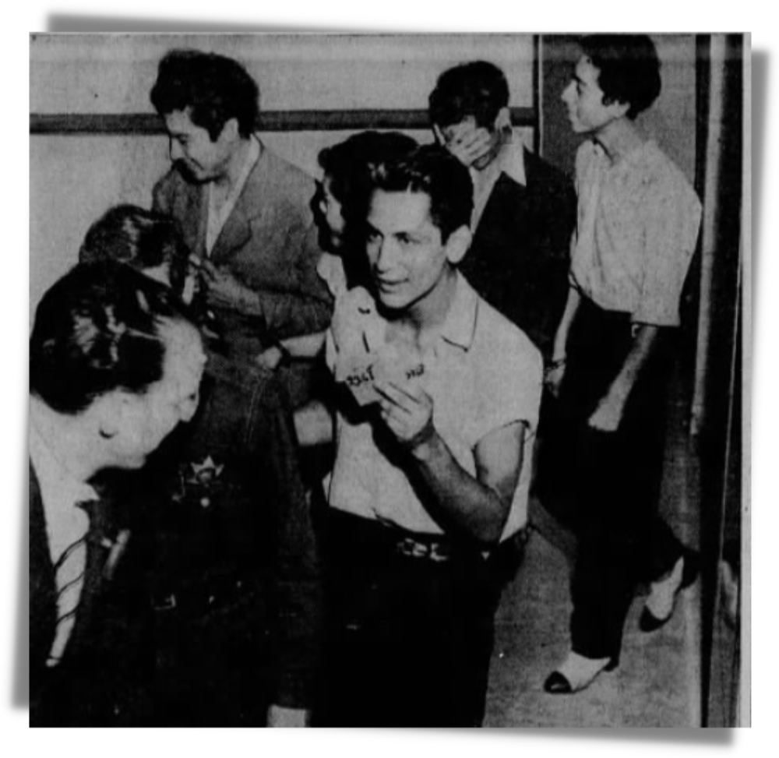
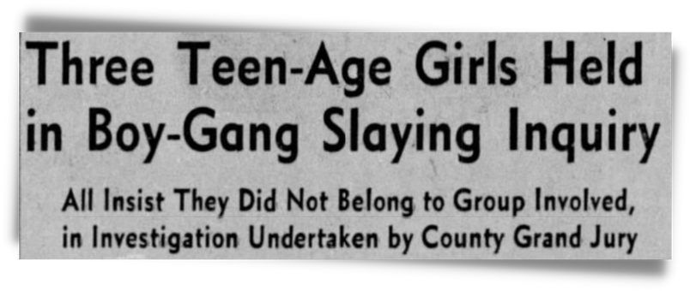
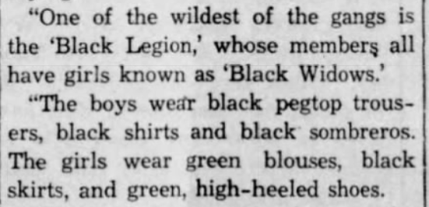

Slide 16
"The defendants have a distinctive appearance and for purposes of identification this distinctive appearance should be maintained."
Deputy District Attorney Clyde Shoemaker

Slide 17
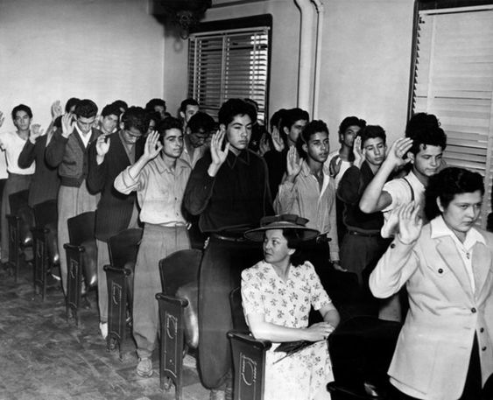
OCTOBER 13, 1942: PEOPLE V. ZAMMORA

Slide 18
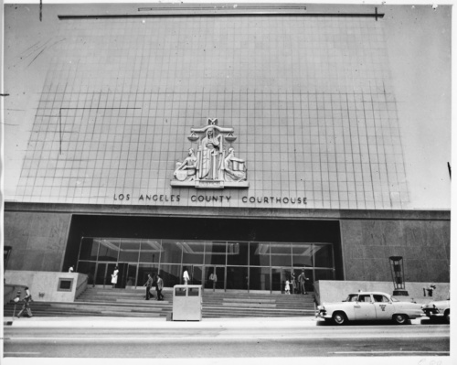
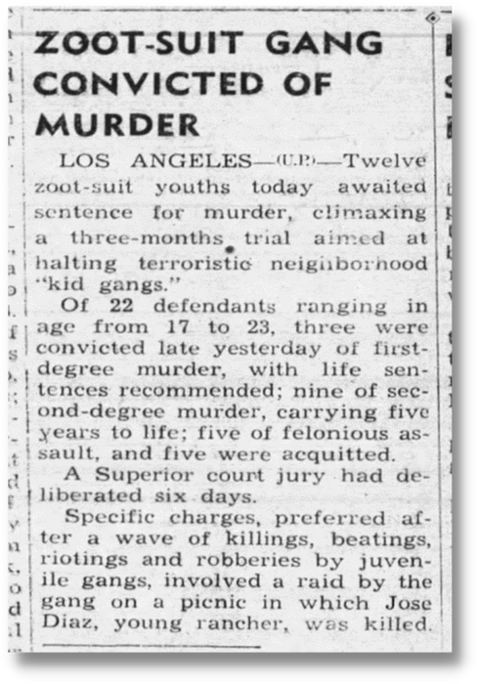
CONVICTED! JANUARY 23, 1943
12 "zoot-suit gang" members are found guilty of murder.

Slide 19
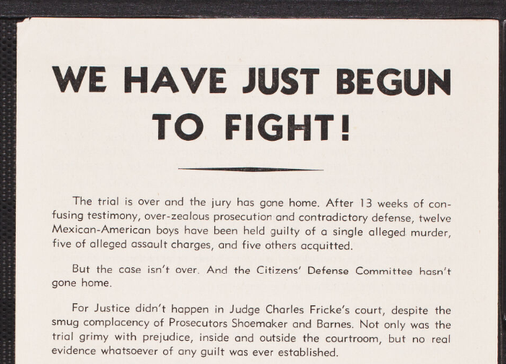

Slide 20
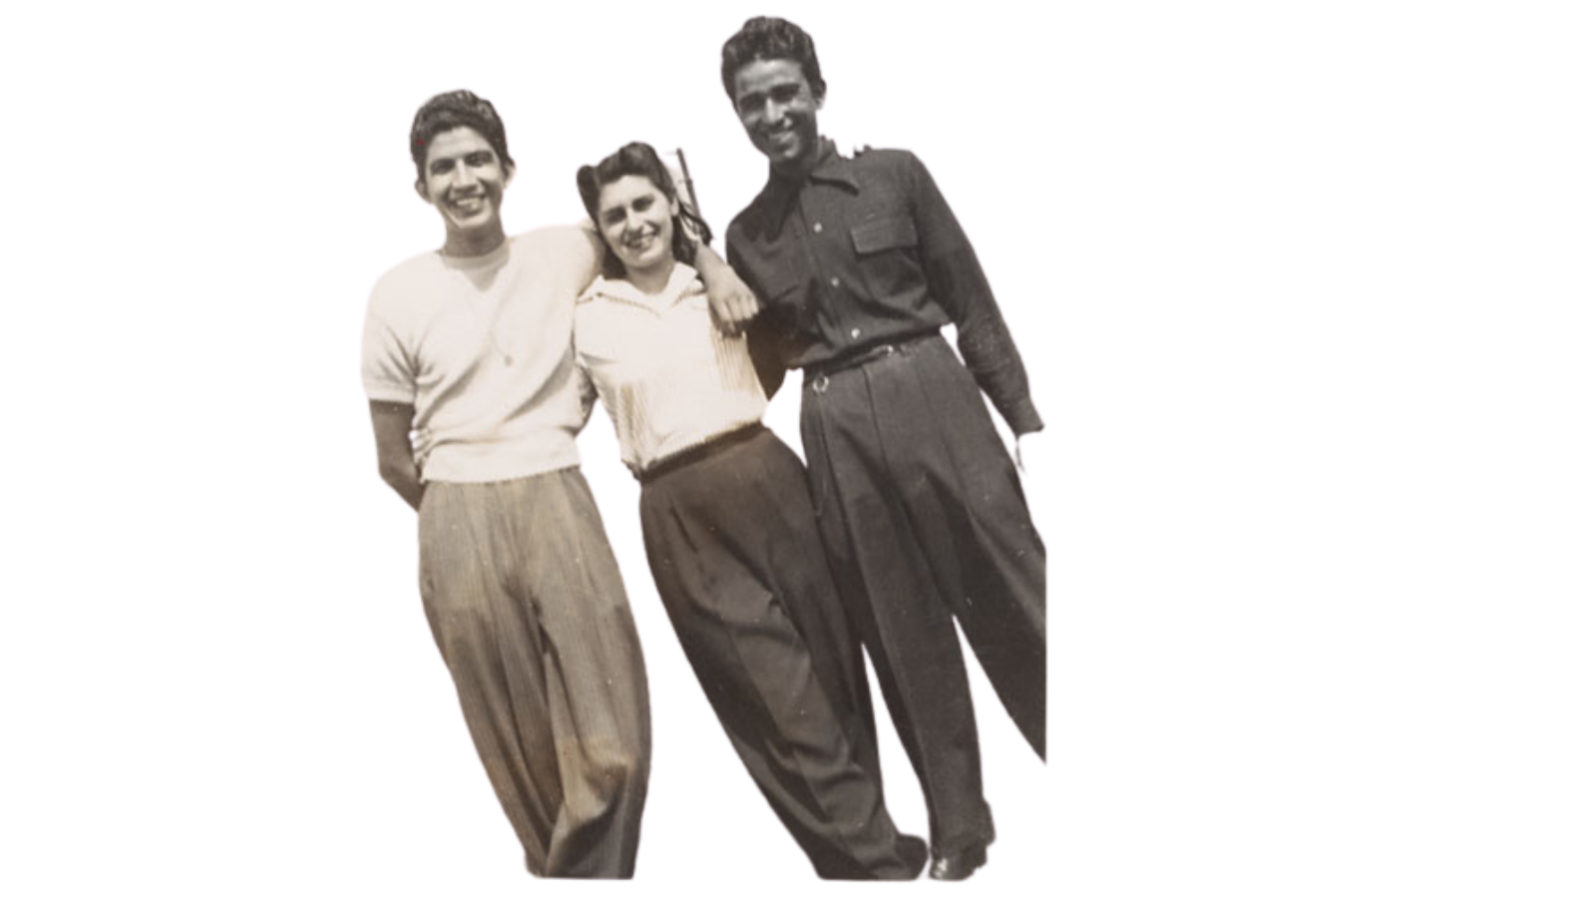
"I was enraged. I just was so upset about the judge and the whole way this trial was going. The behavior of the judge was simply unacceptable in any decent society."
Alice McGrath, Sleepy Lagoon Defense Committee
Alice McGrath with Jack Melendez and Hank Ynostroza in 1944

Slide 21
THEY WERE CONVICTED BY THE HYSTERICAL PRESS WHICH INFLAMED THE MINDS OF THE PEOPLE THROUGH THE NATION TO AN UNREASONING HATRED OF THE BOYS ON TRIAL.
Sleepy Lagoon Defense Committee

Slide 22
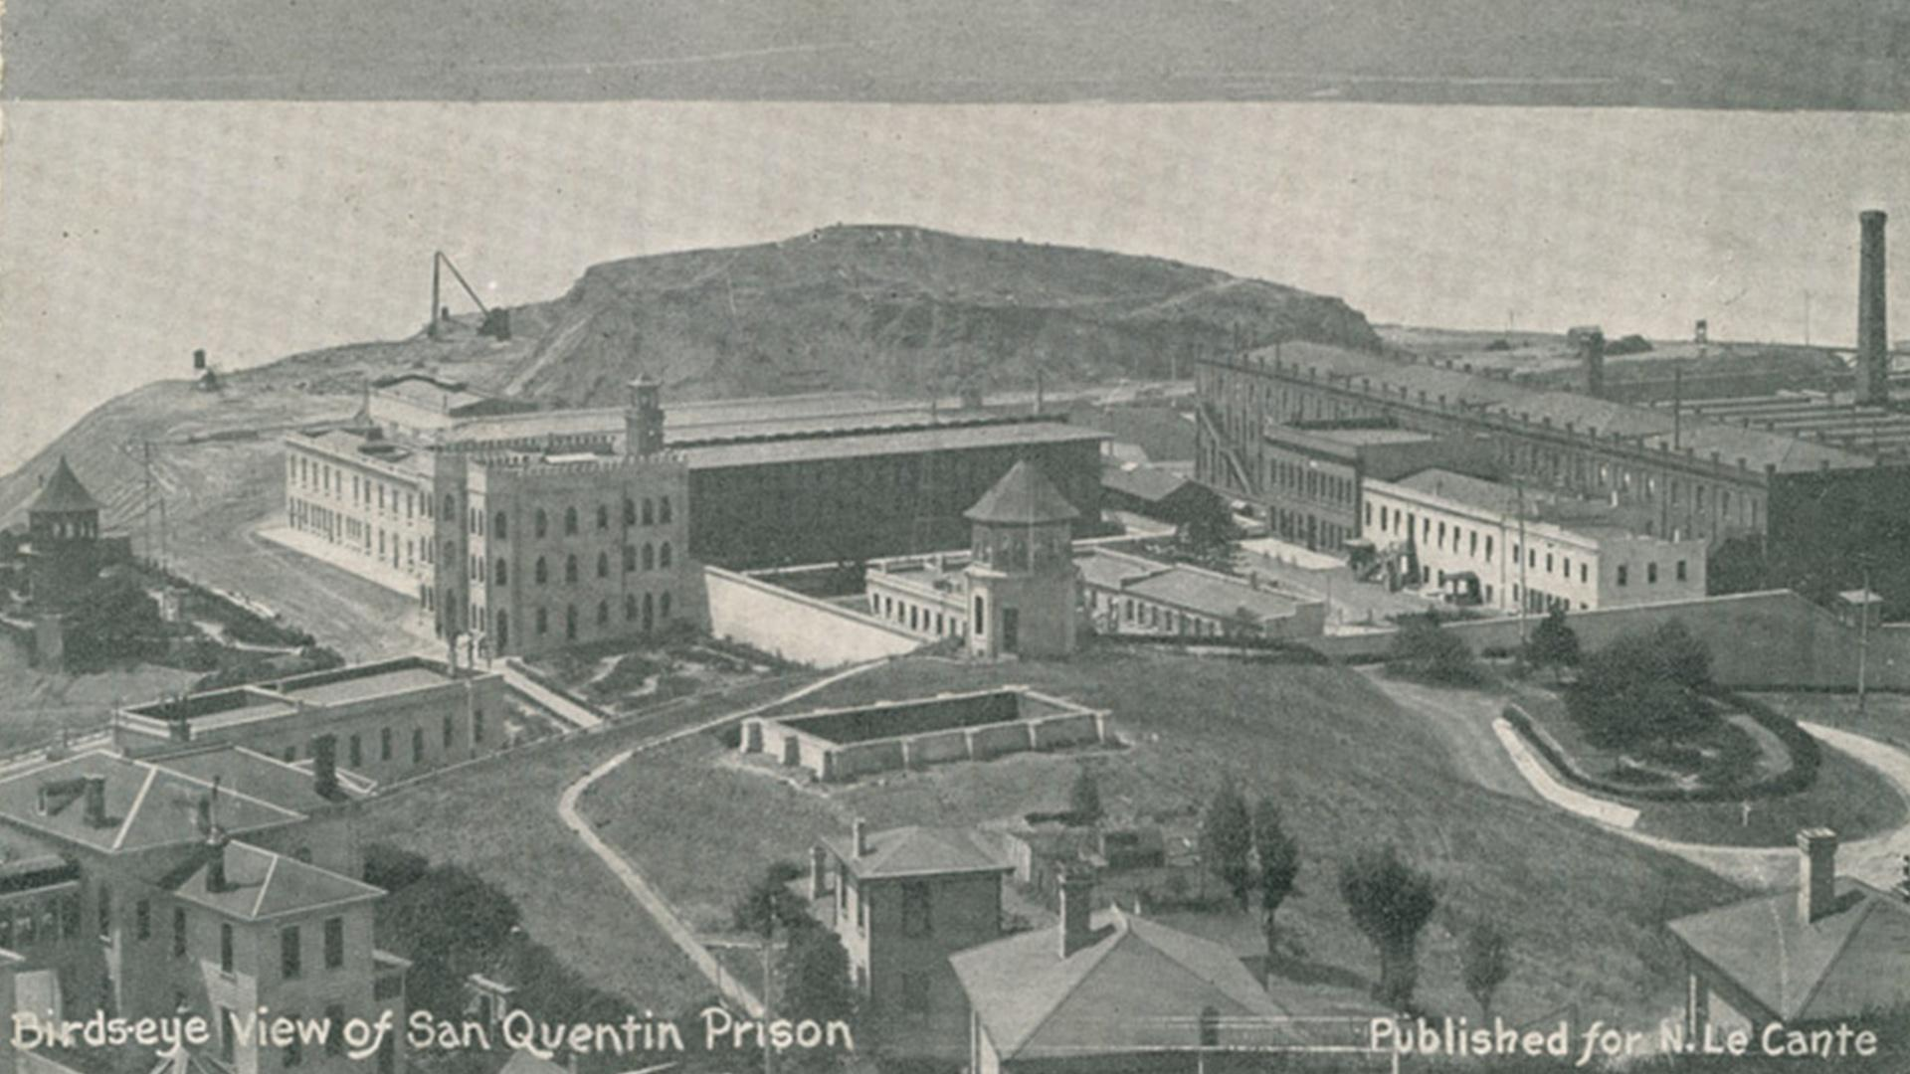
They are sent to San Quentin Prison, hundreds of miles away from their families, for terms 5 years to life.

Slide 23
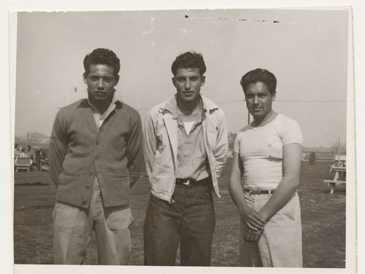
There wasn’t any evidence the boys ever went near José Díaz.
A witness testified that Díaz had been drinking heavily all day.
The judge didn’t instruct the members of the jury not to read the news headlines.
Gus Zamora, "Smiles" Parra and Johnny Matuz at Chino prison

Slide 24
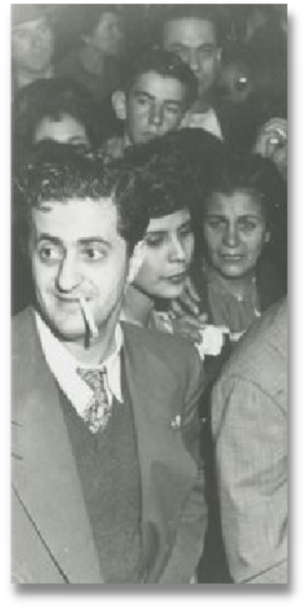
“public hysteria, public opinion, and publicity” made a fair trial with impartial jurors in Los Angeles impossible.”
MOTION FOR NEW TRIAL
– Defense Attorney George Shibley

Slide 25
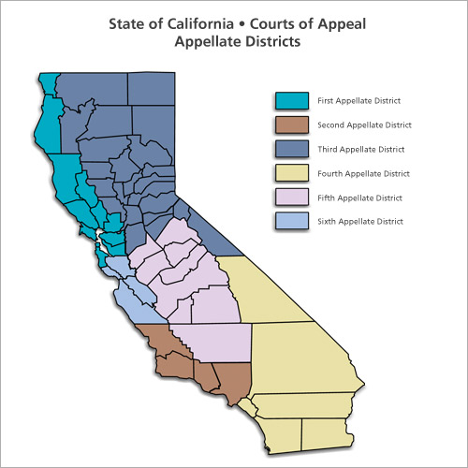

Slide 27
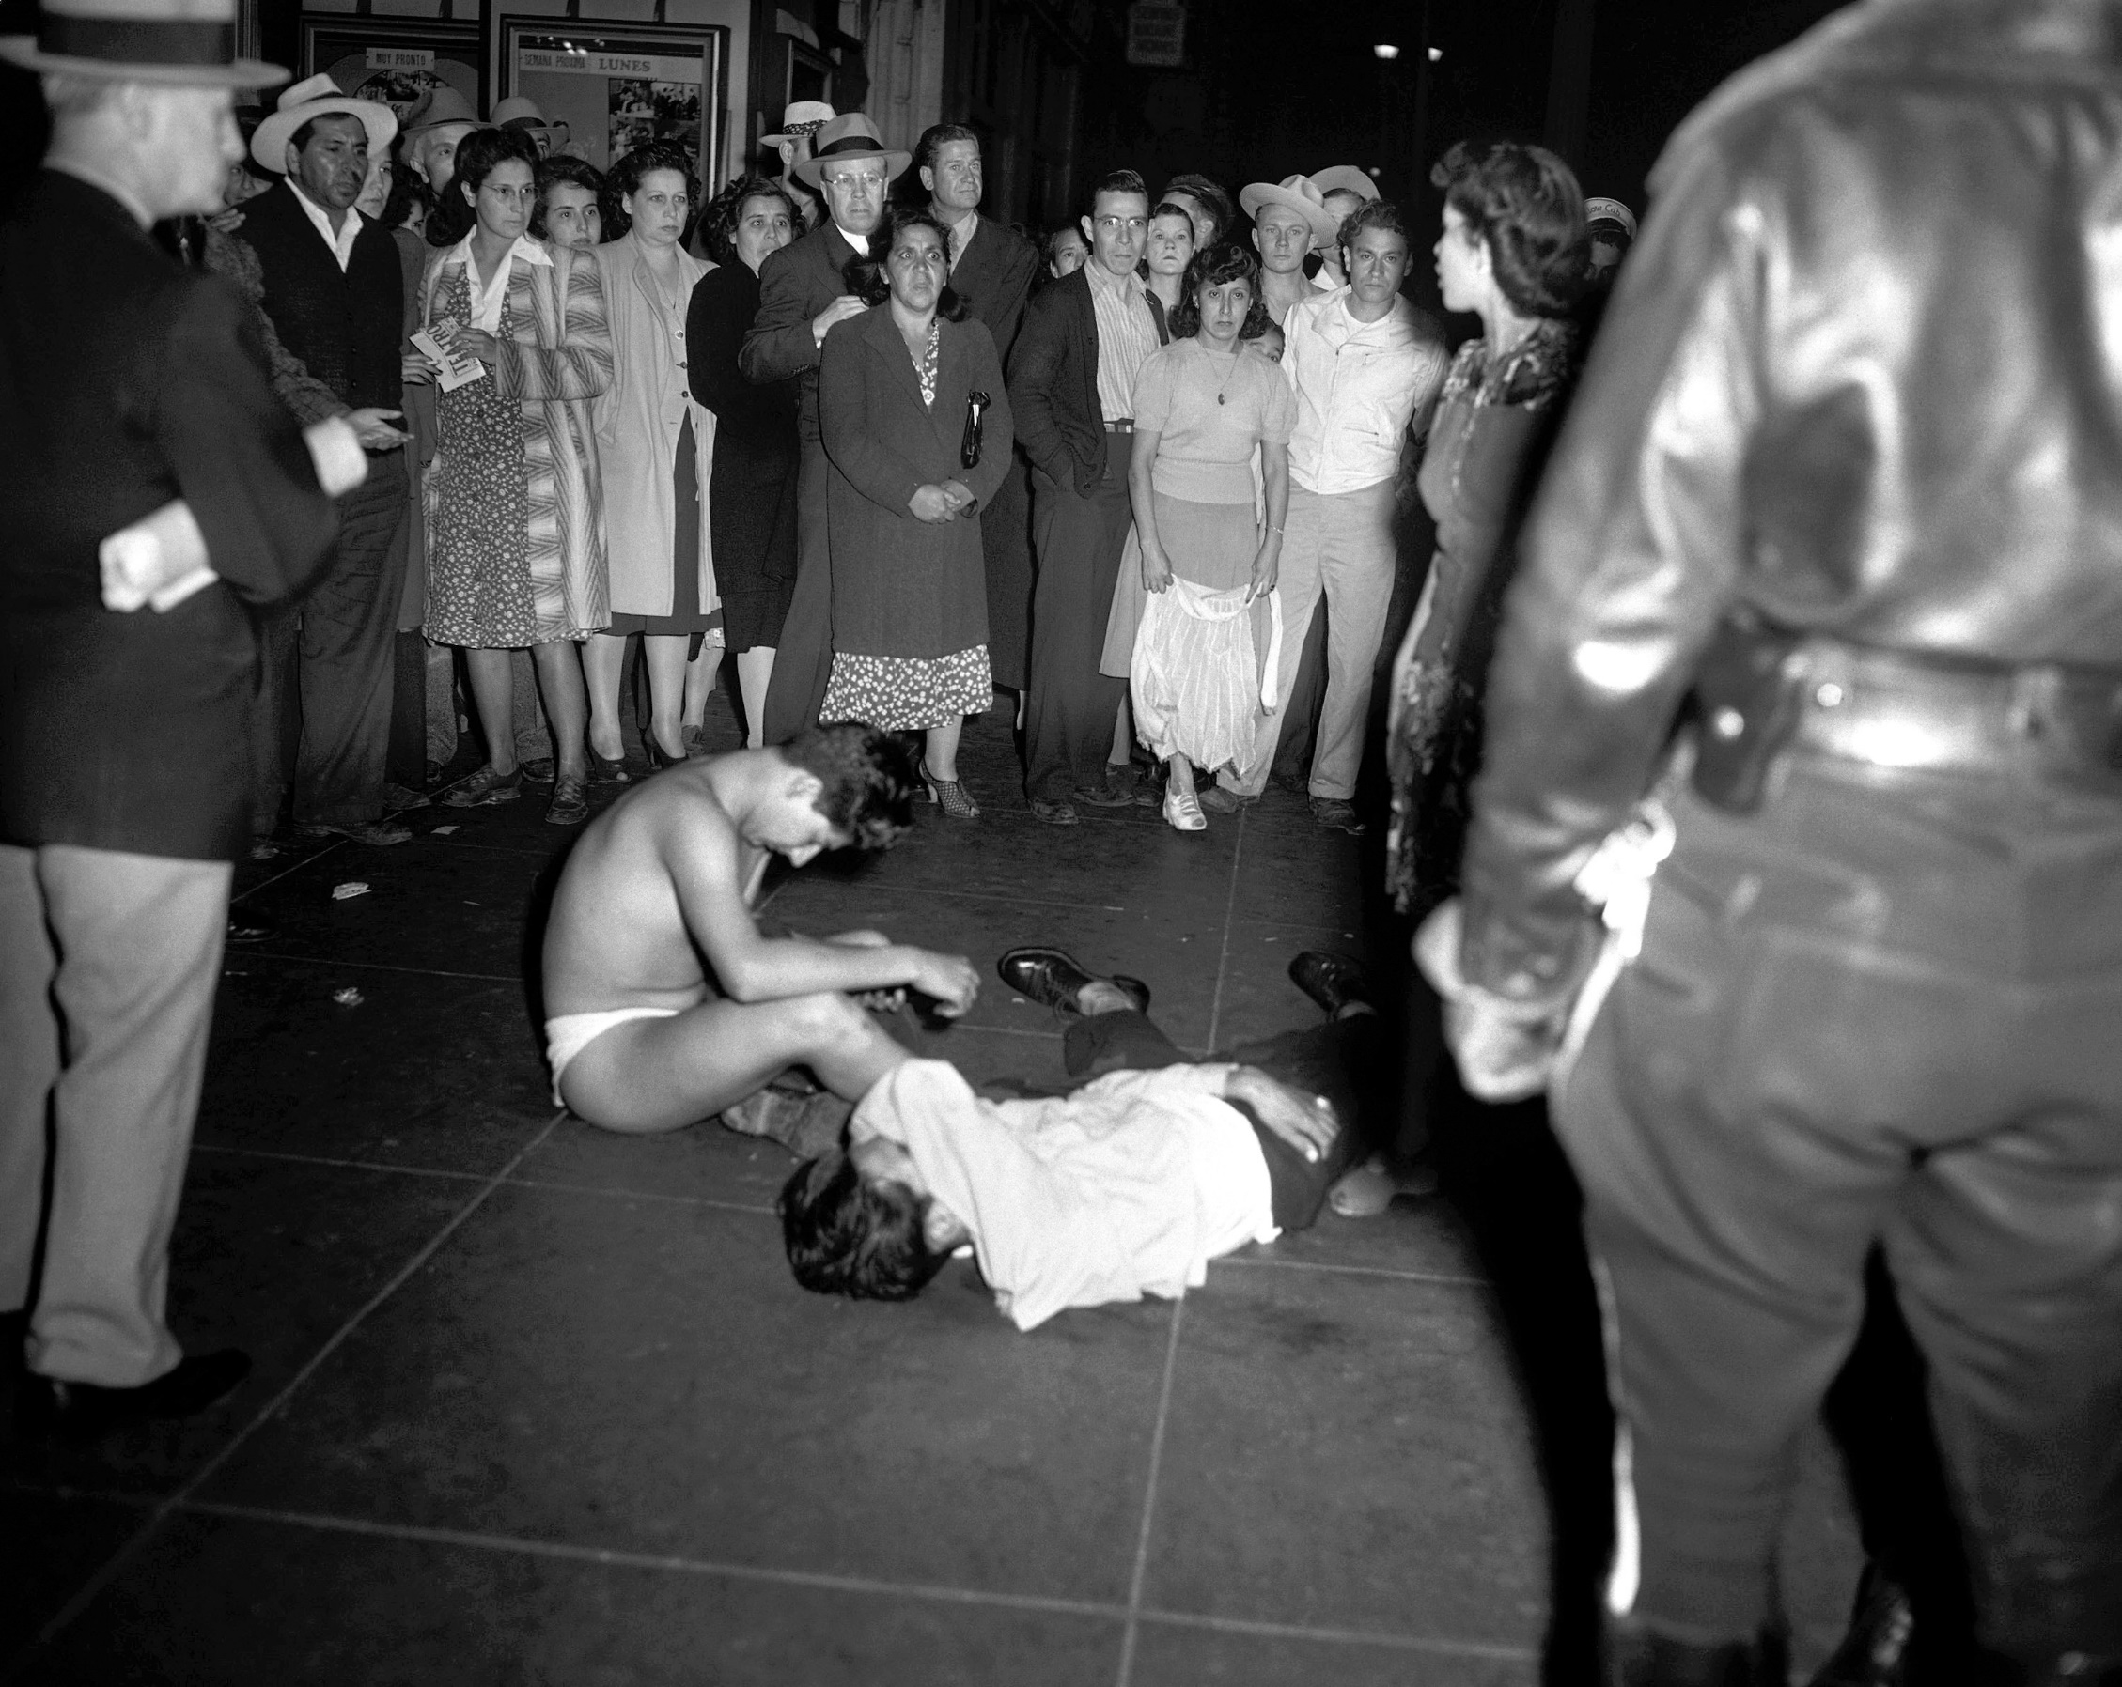
"Zoot Suit Riots."
June 3–8, 1943

Slide 28
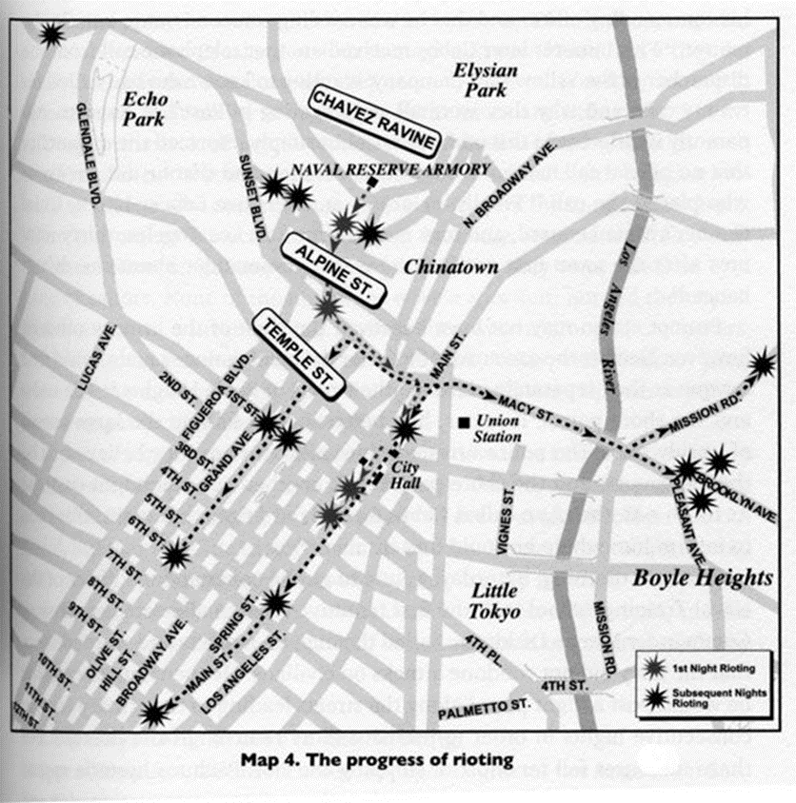

Slide 29
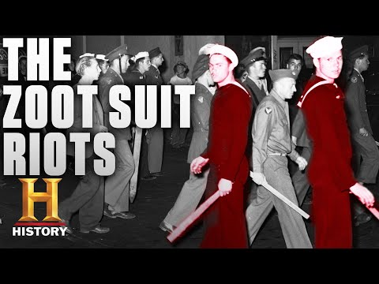

Slide 30
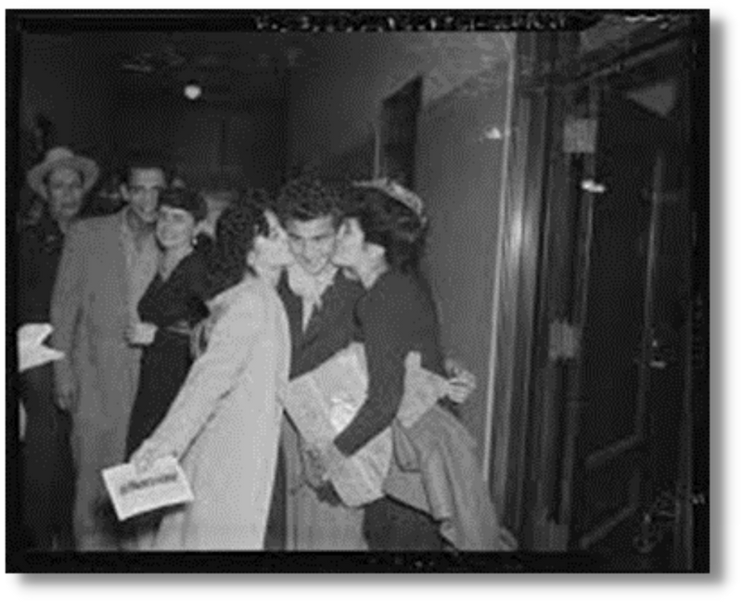
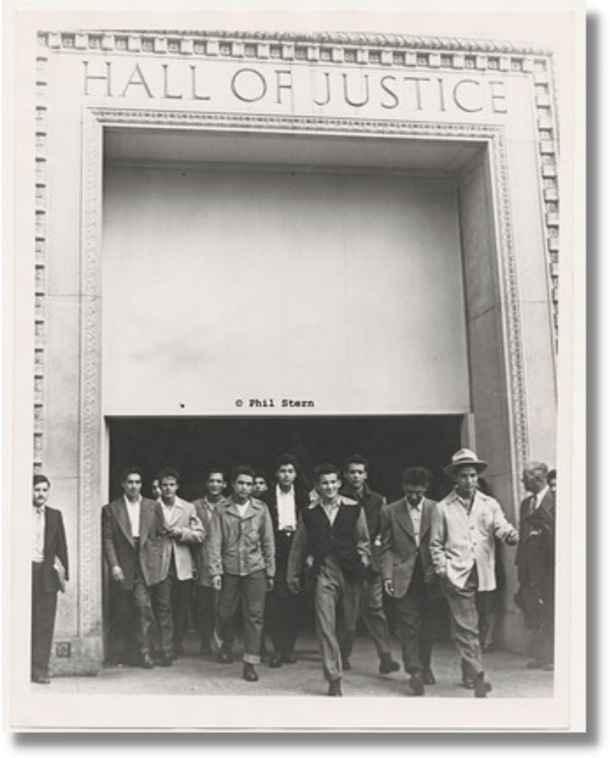
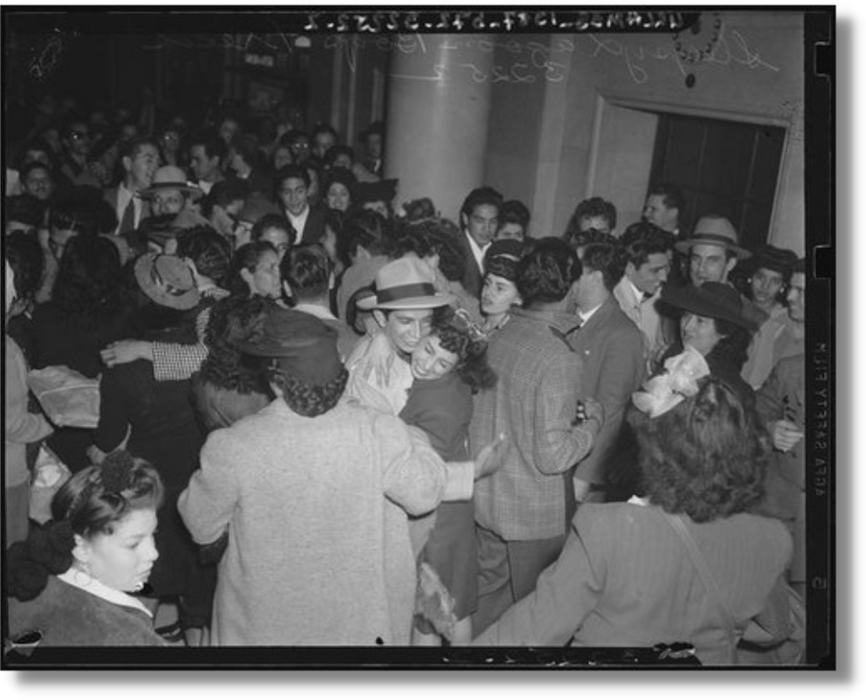
REVERSAL ON APPEAL! OCTOBER 1944

Slide 31
[The convictions were unfairly] founded upon unreasonable inferences, speculation or suspicion."
[There was] a complete lack of material and relevant evidence."

Slide 32
PREJUDICIAL ERROR WAS COMMITTED BY THE COURT, WHICH DEPRIVED APPELLANTS OF THEIR RIGHTS GUARANTEED BY THE DUE PROCESS CLAUSE OF THE FOURTEENTH AMENDMENT TO THE CONSTITUTION OF THE UNITED STATES...

Slide 33
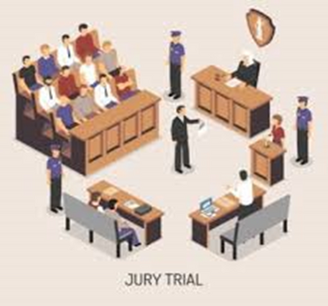
YOUR RIGHTS UNDER THE 14th AMENDMENT
14
TH
RIGHT TO A TRIAL
RIGHT TO AN ATTORNEY
AMENDMENT
You also have the right to a jury of your peers to decide if you did or did not break the law.
If you cannot pay for a lawyer, the government will provide you one for free.

Slide 34
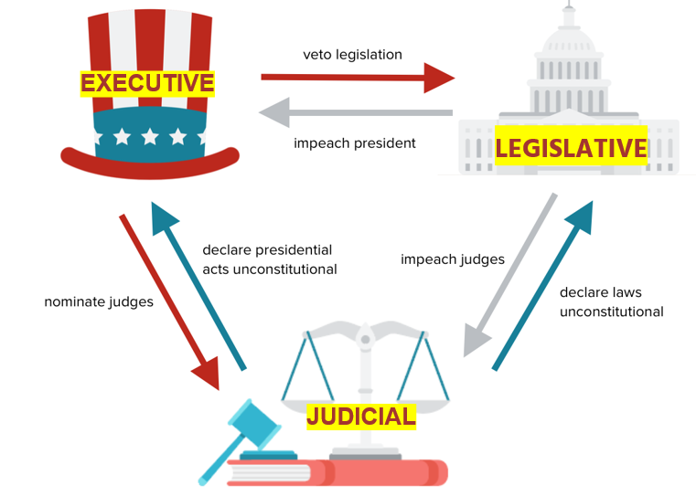

Slide 35
A Report written at the request of the Governor of California in 1943 Concluded:
“In undertaking to deal with the cause of these outbreaks, the existence of race prejudice cannot be ignored.”
“Any American citizen suspected of crime is entitled to be treated as an individual, to be indicted as such, and to be tried, both at law and in the forum of public opinion, on his merits or errors, regardless of race, color, creed, or the kind of clothes [worn].”

Slide 36
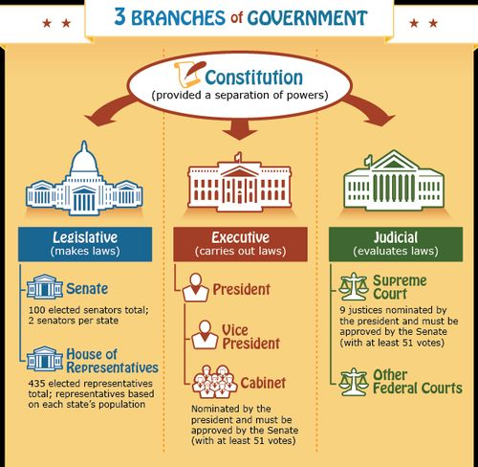

Slide 37
THE JUDICIAL BRANCH

Slide 38
4.4 Million Case Filings
6,500 Filings
15,000 Filings
59 written opinions

Slide 39
Let's Reflect:
Why were the Sleepy Lagoon defendants found guilty?
Do we see similar cultural styles being profiled today?
How does/can the Constitution protect citizens?

Slide 40
TODAY, IT IS STILL IMPORTANT WE PROTECT THE RIGHTS TO A FAIR TRIAL AND TO A LAWYER

Slide 41
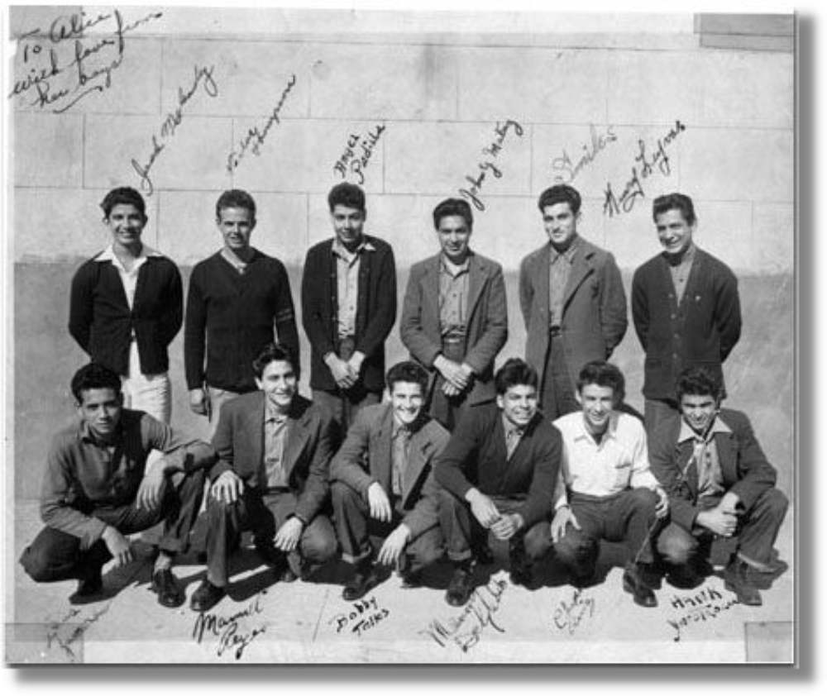
Questions?

