Slide 1
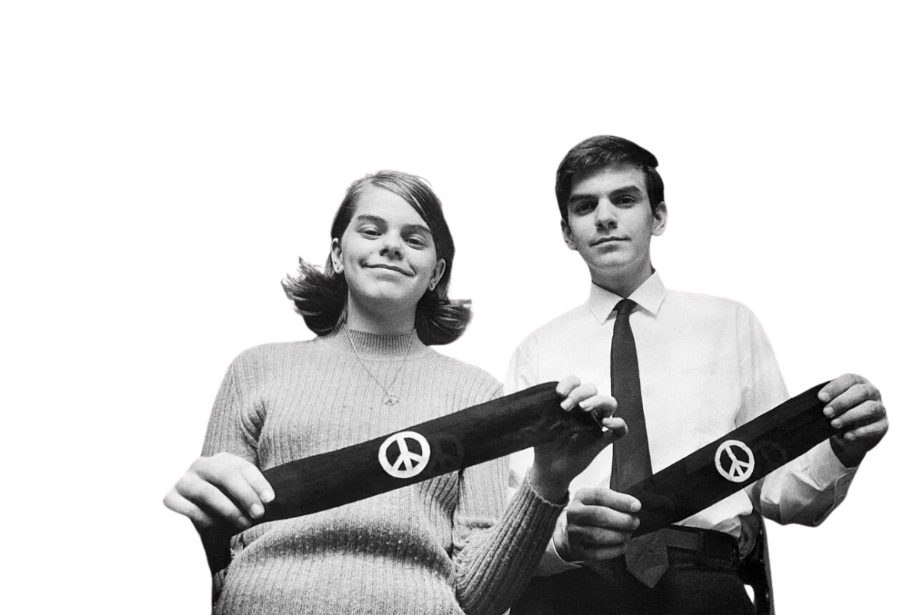
The First Amendment

Slide 3
What is the First Amendment?

Slide 4
What is the First Amendment?
“Congress shall make no law respecting an establishment of religion, or prohibiting the free exercise thereof; or abridging the freedom of speech, or of the press; or the right of the people peaceably to assemble, and to petition the Government for a redress of grievances.”

Slide 5
Are these basic rights always guaranteed?

Slide 6
Judicial Review

Slide 7
Tinker v. Des Moines Independent Community School District (1968-1969)
On December 16, Mary Beth Tinker and Christopher Eckhardt wore their armbands to school and were sent home. The following day, John Tinker did the same with the same result.
The students did not return to school until after New Year's Day, the planned end of the protest.

Slide 8
Tinker v. Des Moines Independent Community School District (1968-1969)
"...the principals have the authority to control any activity that they feel disrupts the general education program."
–School District

Slide 9
Tinker v. Des Moines Independent Community School District (1968-1969)
Did the school suspending the students for their silent protest violate their first amendment rights?

Slide 10
Tinker v. Des Moines Independent Community School District (1968-1969)
"Our problem lies in the area where students in the exercise of First Amendment rights collide with the rules of the school authorities. . . . "
Majority Opinion, Justice Abe Fortas
U.S. Supreme Court

Slide 11
Outcome of the case
The final ruling was 7-2 in favor of Tinker
Students do NOT lose their constitutional rights in school
Protected under First and Fourteenth Amendments

Slide 12
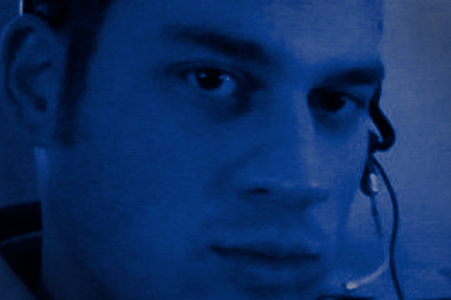
Elonis v. U.S. (2014)

Slide 13
Elonis v. U.S. (2014)
Anthony Elonis, aka “Tone Dougie,” posted lyrics on Facebook that fantasized about physically harming his wife, local students, and federal officers.
Elonis ended one post with this statement:
"Art is about pushing limits. I'm willing to go to jail for my constitutional rights. Are you?"

Slide 14
Elonis v. U.S. (2014)
His statements were interpreted as a threat. Elonis was convicted and sentenced to 44 months in prison.
United States District Court for the Eastern District of Pennsylvania

Slide 15
United States District Court for the Eastern District of Pennsylvania
United States Third Circuit

Slide 16
GUILTY
GUILTY
United States District Court for the Eastern District of Pennsylvania
United States Third Circuit

Slide 17
Elonis v. U.S. (2014)

Slide 18
Elonis v. U.S. (2014)
Does a conviction of threatening another person under federal anti-threat statute require proof that the defendant meant what he said in a literal sense?

Slide 19
Elonis v. U.S. (2014)
The Ruling:
Since there is no proof of subjective intent (whether or not he intended to follow through), he cannot be held accountable for the "recklessness" of his actions.
Why this matters:
This was the first Supreme Court case in which social media was at the forefront.
This case set precedent for how free speech is exercised online.

Slide 20
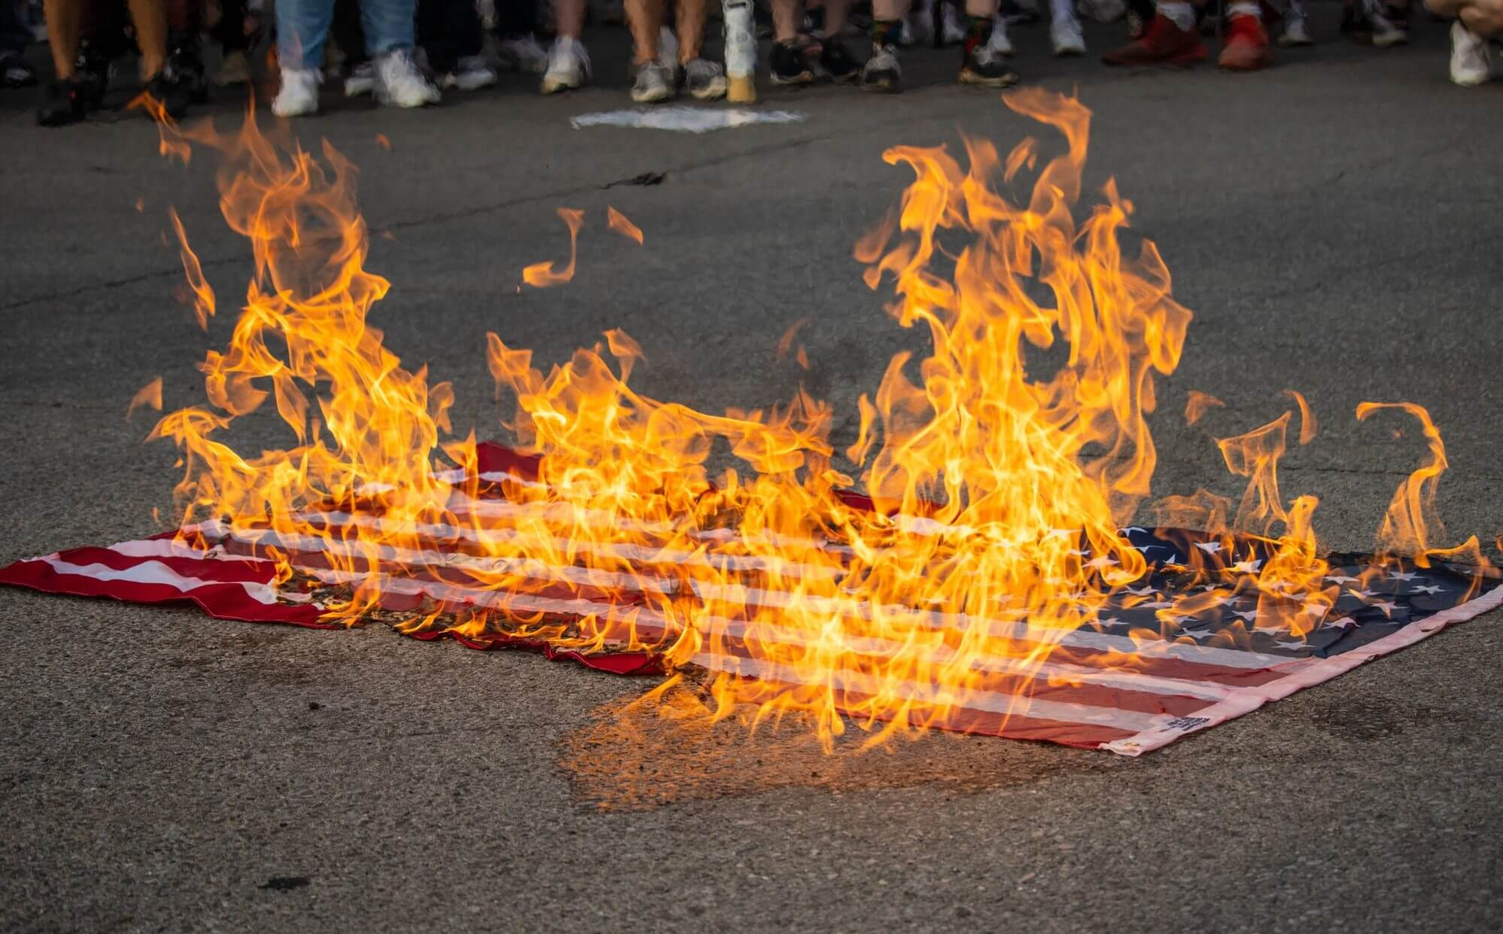
Texas v. Johnson (1989)

Slide 21
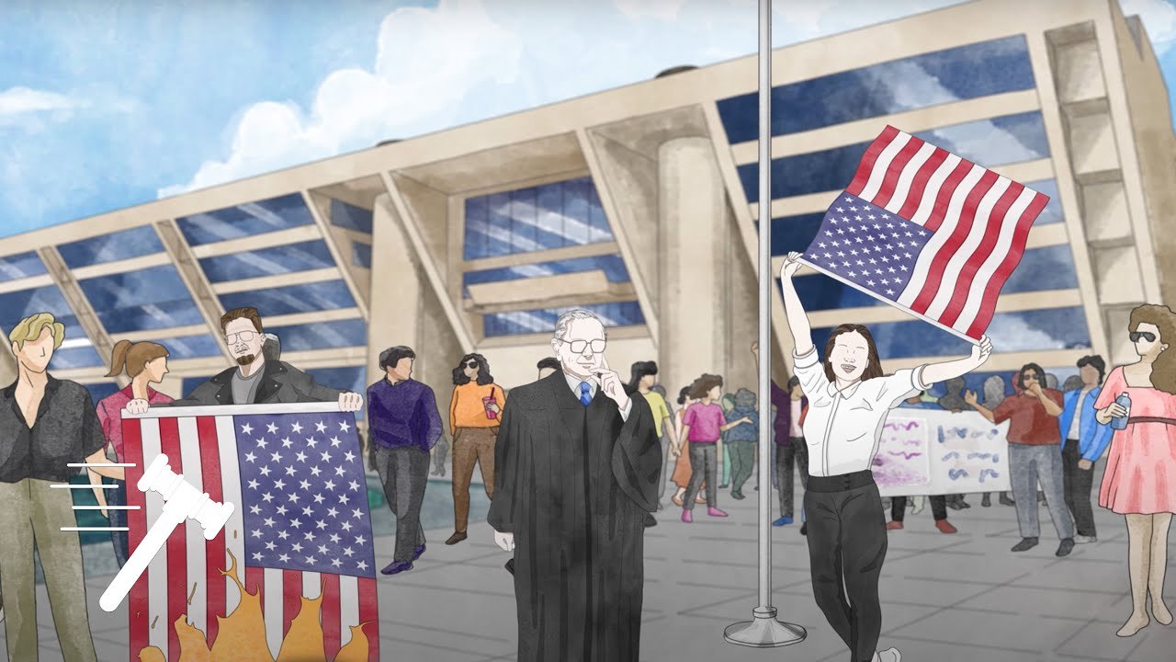
Texas v. Johnson (1989)
The 1984 Republican National Convention was held in Dallas, Texas. During the convention Gregory Lee Johnson and a group of political activists marched through the streets protesting. When the demonstrators reached Dallas City Hall, Johnson poured gas on an American flag and burned it. Johnson was arrested and convicted under a Texas state law.

Slide 22
Texas v. Johnson (1989)

Slide 23
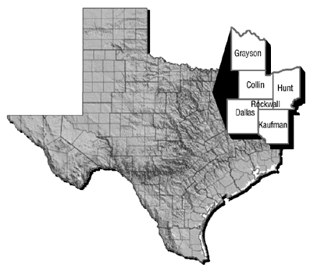
Texas v. Johnson (1989)
Johnson appealed his case before Texas’ 5th District Court of Appeals.

Slide 24
Texas v. Johnson (1989)
Johnson appealed his case before Texas’ 5th District Court of Appeals.
The court overruled the lower court’s decision, citing the 1st amendment stating a government cannot decide what can and cannot be picked as protected under free speech, even if the act is divisive.

Slide 25
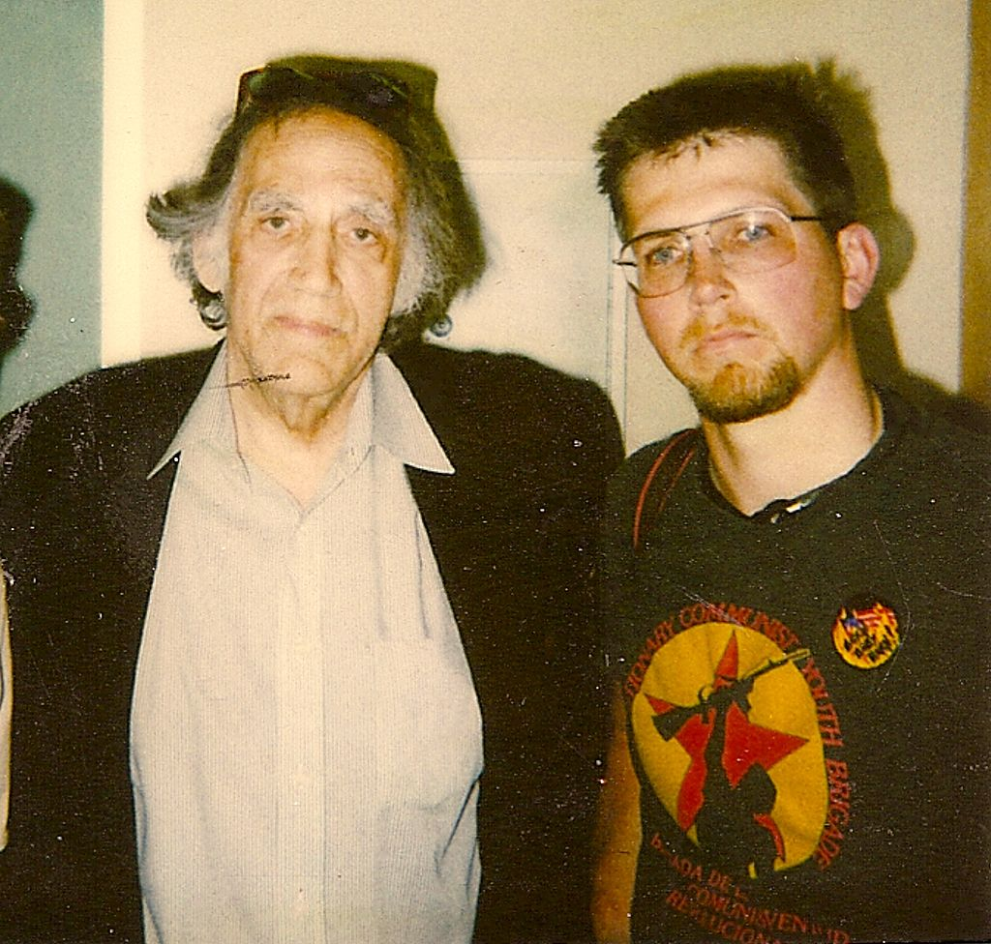
Texas v. Johnson (1989)
In 1989, the case was brought before the United States Supreme Court.
The Ruling:
The U.S. Supreme Court ruled in a 5-4 decision in favor of Johnson. The high court agreed that symbolic speech – no matter how offensive to some – is protected under the First Amendment.
Gregory Lee Johnson (right) with his attorney, 1989
Why it Matters:
Symbolic speech is protected, so protests that involves an act such as burning the American flag are legal. The fact that an audience takes offense to certain ideas or expression, the Court found, does not justify prohibitions of speech.

Slide 26
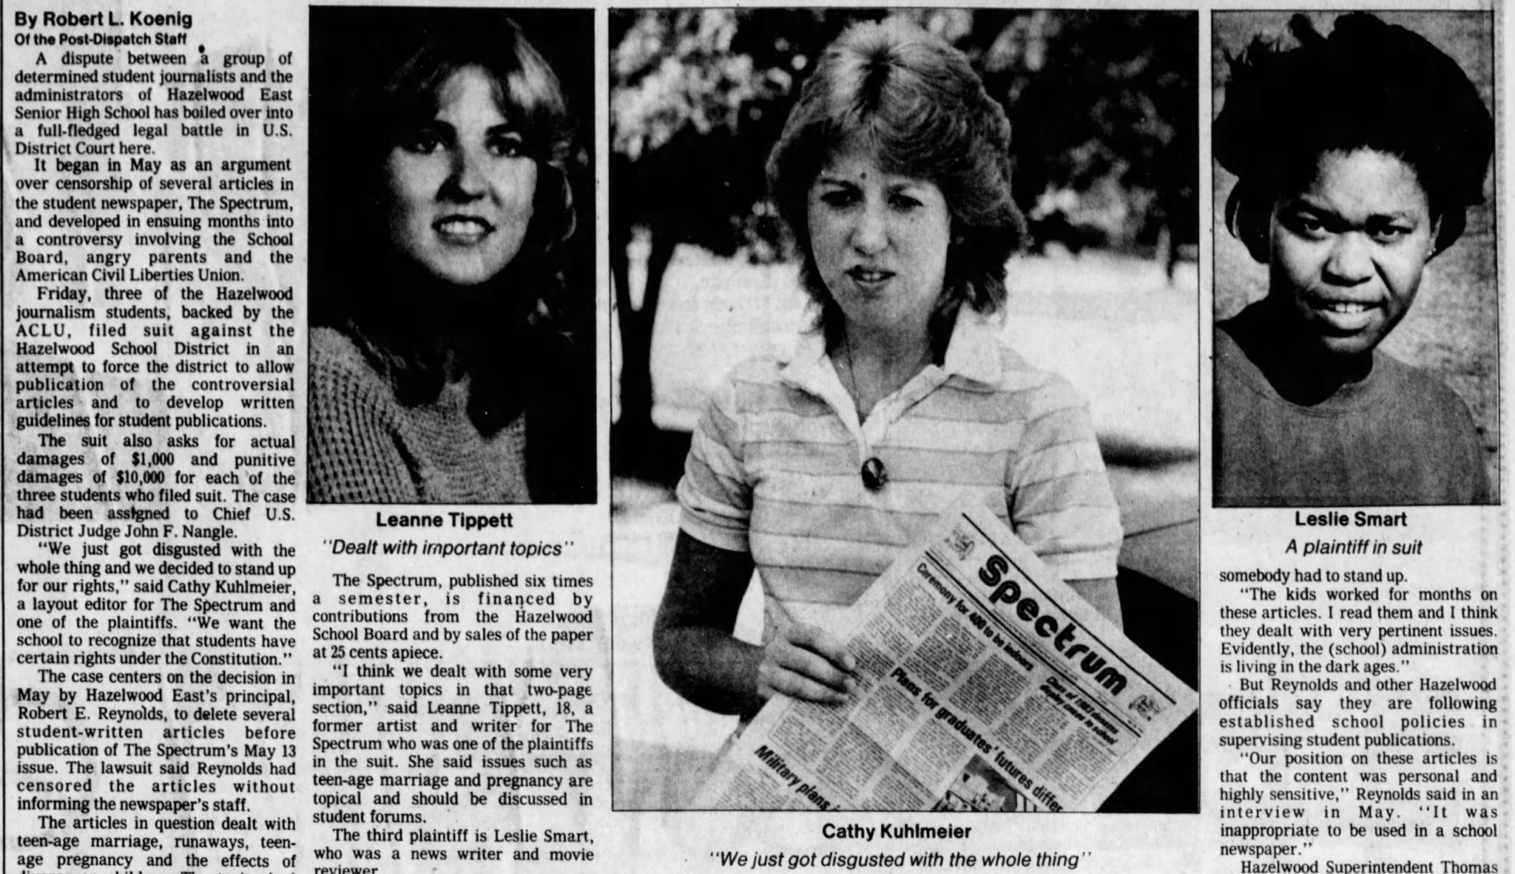
Hazelwood School District v. Kuhlmeier (1988)

Slide 27
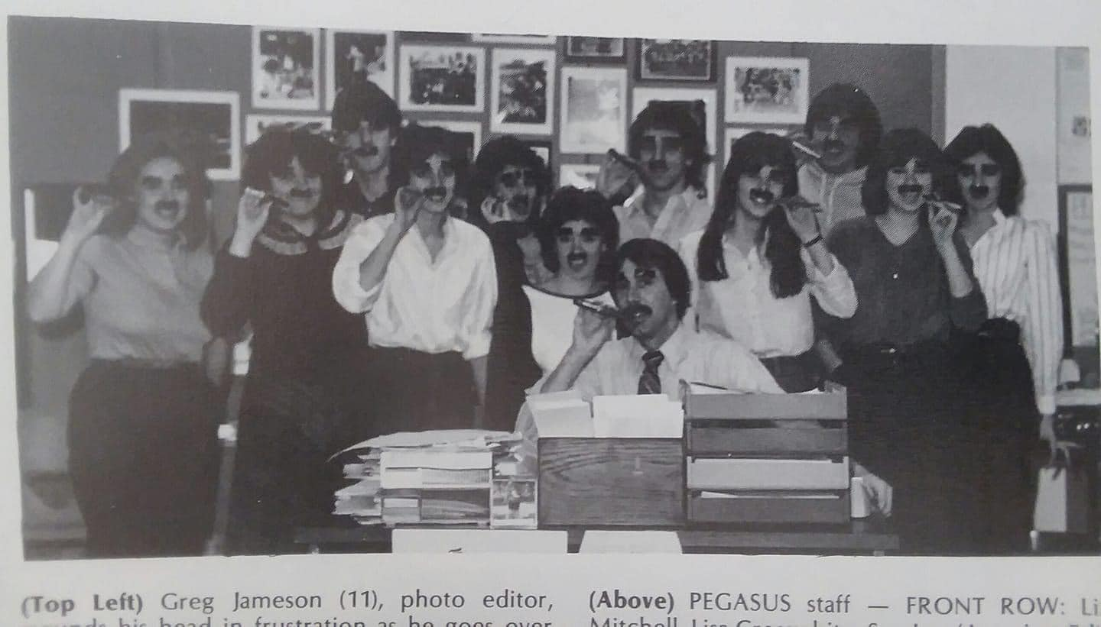
Hazelwood School District v. Kuhlmeier (1988)
Cathy Kuhlmeier and other students in the Journalism II class at Hazelwood East High School wrote articles for their newspaper—The Spectrum. When their articles on teen pregnancies, divorce, and runaways “pushed the boundaries,” the principal ordered the articles stricken. Kuhlmeier and others took the school to court.

Slide 28
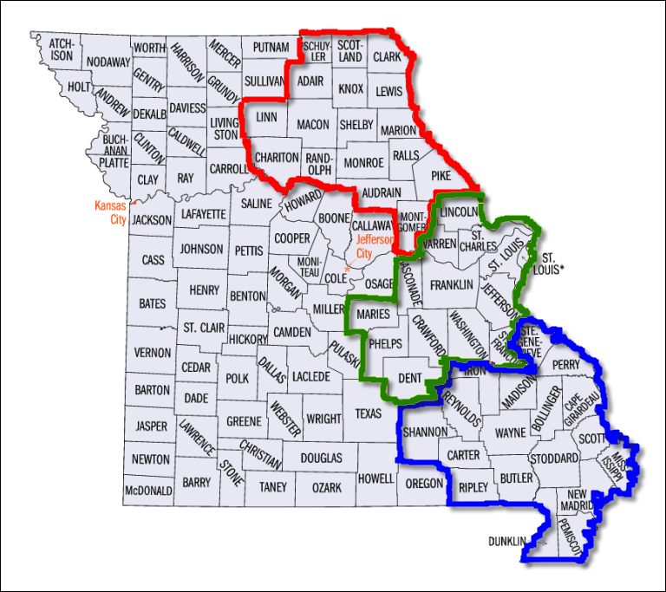
Hazelwood School District v. Kuhlmeier (1988)
U.S. District Court for the Eastern District of Missouri

Slide 29
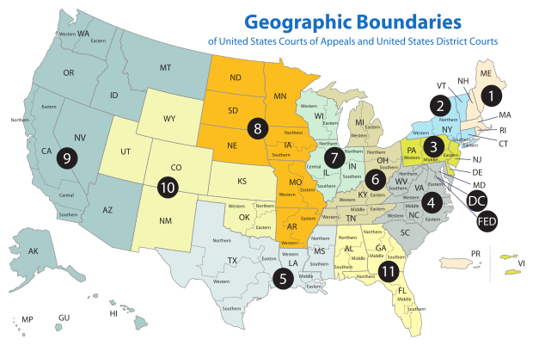
Hazelwood School District v. Kuhlmeier (1988)
U.S. District Court for the Eastern District of Missouri
U.S. Court of Appeals for the Eighth Circuit

Slide 30
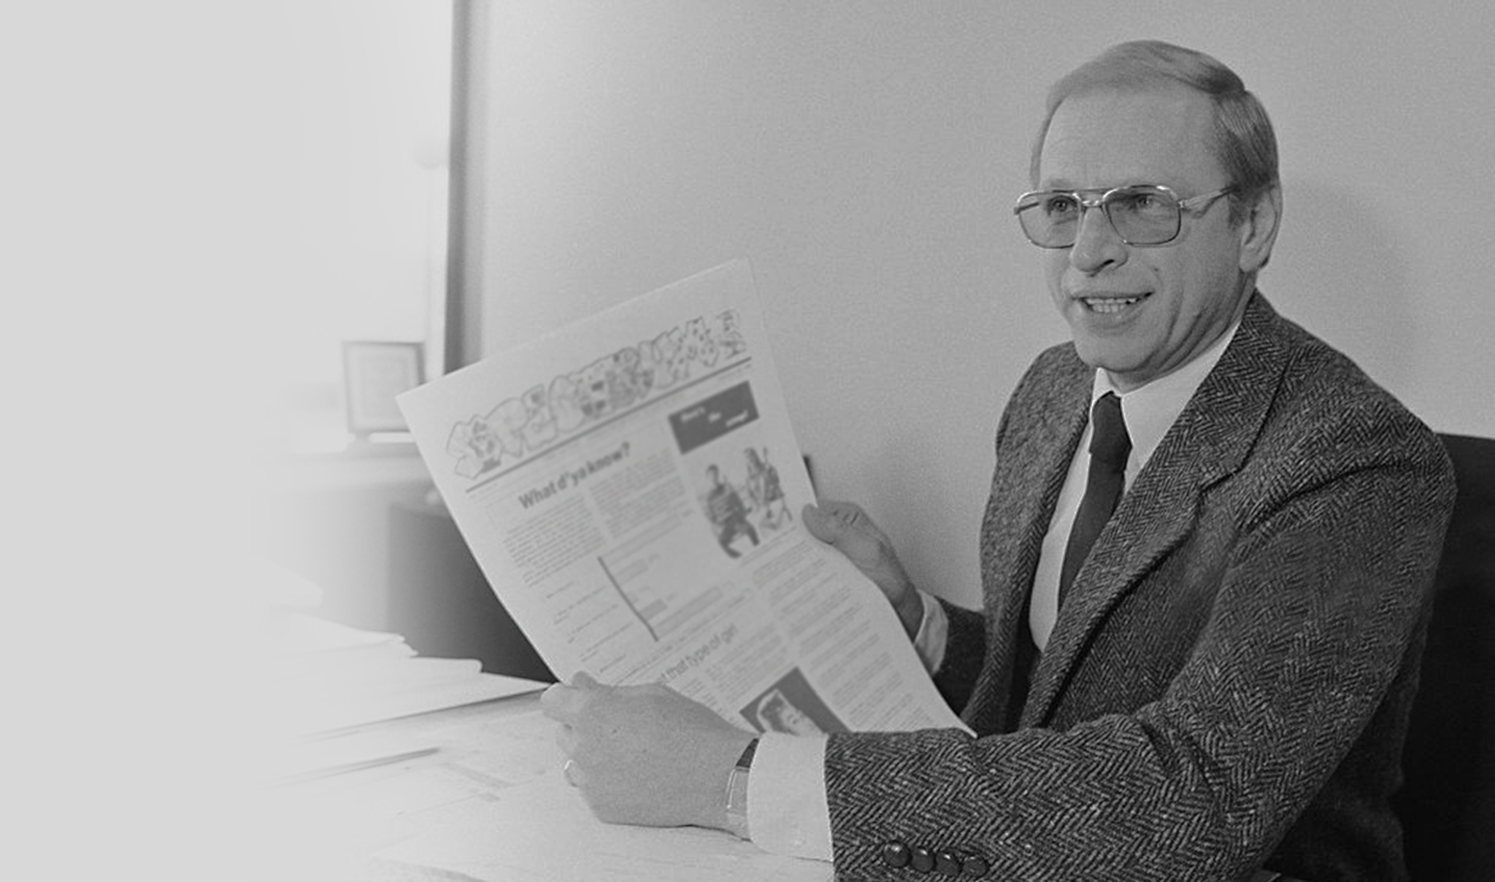
Does freedom of speech/press apply to school newspapers?

Slide 31
Hazelwood School District v. Kuhlmeier (1988)
The Ruling:
Public schools do not have to allow student speech as long as the censorship is “reasonably related” to educational concerns and the student speech "inconsistent with 'the shared values of a civilized social order.'”
Why this matters:
This case created the modern state of journalism in schools, which many view as a form of censorship. Schools are allowed to omit articles that do not align with the narrative of the school's administration. This case illustrated how schools retain jurisdiction over policies for the students under their supervision.

Slide 32
303 Creative LLC v. Elenis (2023)
Lorie Smith runs a Colorado graphics and web design company called 303 Creative. She opposes same-sex marriage and wanted to post a disclaimer stating she would not create any website that is for same-sex couples.

Slide 33
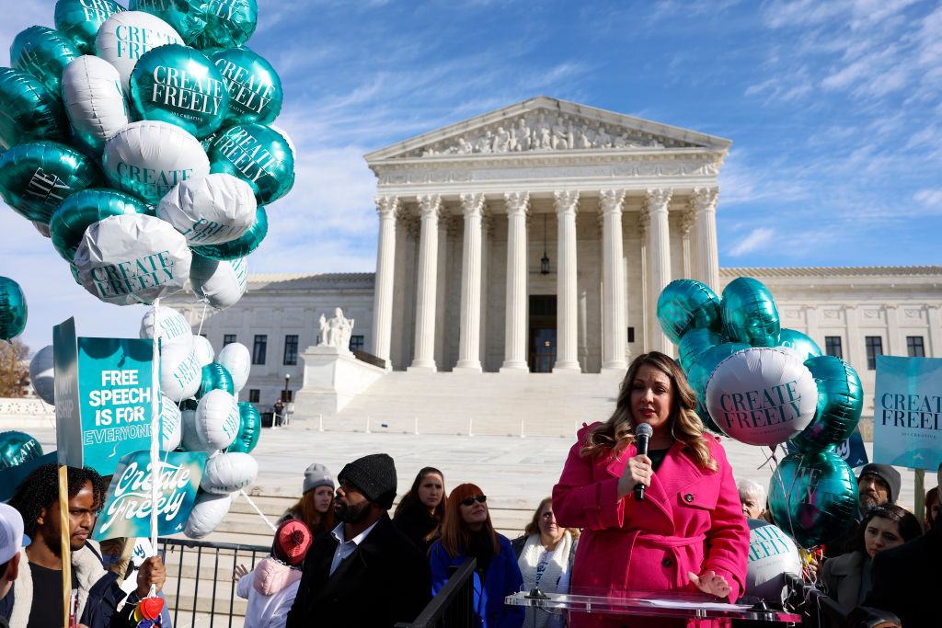
303 Creative LLC v. Elenis (2023)
Does application of the Colorado Anti-Discrimination Act to compel an artist to speak or stay silent violate the Free Speech Clause of the First Amendment?

Slide 34
303 Creative LLC v. Elenis (2023)
The Ruling:
The First Amendment prohibits Colorado from forcing a website designer to create expressive designs that convey messages with which the designer disagrees.
Why this matters:
This case sets a precedent where businesses are able to refuse service to those who they morally oppose. This can be cited in courts across the United States through case law.

Slide 35
Morse v. Frederick (2007)
At a school-supervised event, Joseph Frederick held up a banner with the message "Bong Hits 4 Jesus," a slang reference to marijuana smoking. Principal Deborah Morse took away the banner and suspended Frederick for ten days.

Slide 36
“speech limited is speech lost”

Slide 37
Morse v. Frederick (2007)

Slide 38
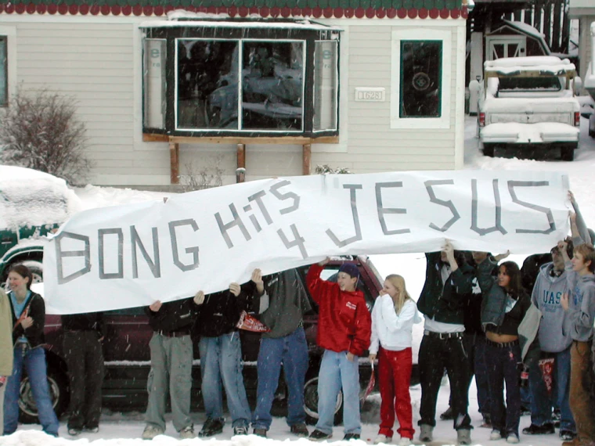
Does holding a sign like the one in this case at a school-sponsored event fall under free speech?

Slide 39
Morse v. Frederick (2007)
The Ruling:
The Supreme Court said that because it was a school-sponsored event, their representation of the school using the sign violates school policy.
Why this matters:
This case determined that school policy may supersede certain laws due to students being under supervision of the school. This further asserted that students do not necessarily get the protection from the laws but because every student signs an agreement to be in the school, they fall under their jurisdiction and are subject to their policies.

Slide 40
Let’s Review

Slide 41
Questions?

